Slide 1


December
2022
Teresa Babin-Lincoln
MKTG270

Slide 2

Mystery Ranch
Current Market Segment
Mystery Ranch is a company who makes durable and dependable outdoor backpacks, travel bags and lifestyle gear targeted towards Outdoor industry professionals. Mystery Ranch takes pride in having specific gear for specific jobs, and takes the needs of their customer’s seriously. Mystery Ranch includes product lines tailored towards Hunting, Wildland Fire, Backpacking, Military, and travel needs.

Slide 3
Problem
Mystery Ranch’s niche market is small and specific.
Mystery Ranch’s customer is an extremist, and can be intimidating to more average customers.
Mystery Ranch relies on influencer marketing, earned media, and word of mouth marketing.
Many potential Mystery Ranch customers have never been exposed to the brand
Singular and Narrow Focus

Slide 4
Solution
Currently, Mystery Ranch markets towards the extremists- and the elite of the outdoor industry. This campaign is looking to maintain brand reputation, but market to a wider cliental of outdoor professionals and hobbyists. While maintaining the strong branding, the Environmental Advocate’s campaign looks to expand the diversity of occupations that Mystery Ranch reaches.
New Campaign
Environmental Activists

Slide 5
Campaign Concept
Primary Target Market
Many of the customers that Mystery Ranch already caters to, and has information and buyer persona’s created for will fit into the category of “Environmental Advocate.”
By creating this new campaign, the brand’s theme will flow together overall, and will allow for the Mystery Ranch net to be cast wider over existing clients, create brand loyalty to under represented folks within the professional outdoor industry, and bring in new customers that fall within the buyer persona’s but were falling outside of the marketing channels and SEO for specific niche customers.

Slide 6
Environmental Activist Overview
Primary Target Market
Those with NO brand exposure
Those with SOME brand exposure
Those in outdoor professional or hobbies positions.
Ex: wildlife photographers, Field Biologists, Trails crews, Conservation program workers, hiking leaders and docents, Urban backpackers.
Soft focus on Women in outdoor industries- the Women Specific lines already exist, it is just about involving women as a target-albeit-niche market.

Slide 7
Primary Target Market
In the buying cycle, these customers are likely in the “Intent” stage of the buying cycle. This new campaign will tip them into the purchase stage.
With a campaign launching in April, this will targeting those recent graduates who will be working a summer field job.
Having the campaign end in August will be when this target market has more money than they did in April, and have spent the past few weeks wishing they had something better.
Those with some brand exposure

Slide 8
Secondary Target Market
This campaign is designed to introduce Mystery Ranch to a new group of potential buyers.
The initial marketing in the campaign is designed to associate a positive memory about the work they enjoy doing with the brand.
This will bring new customers from the “Awareness” and into the “intent” phases of the buying cycle.
Those with NO brand exposure

Slide 9

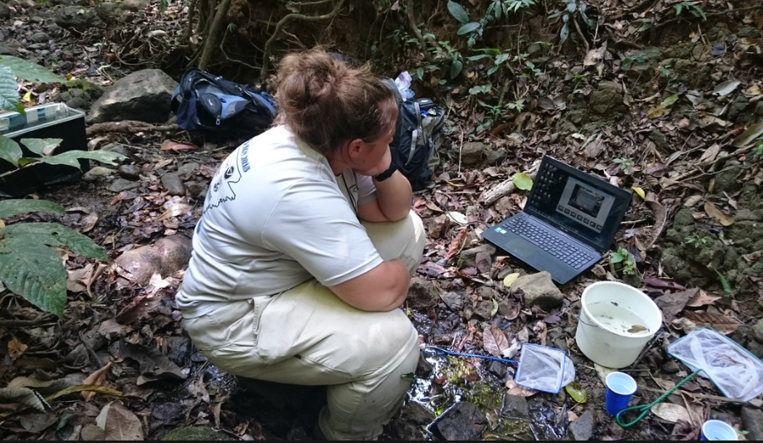





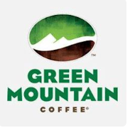
MARKETING & SALES PERSONA
HOPES & DREAMS
To be a Full Time Wildlife Biologist leading a team.
To get into a career position where she doesn’t have to worry about the next paycheck-Willing to travel and relocate
To earn and maintain respect in a male dominated industry
To become a leader in her field, and to be a quality mentor for others.
BACKGROUND
25 years old, Single, Female
First Year Seasonal Biologist for the USFS.
Lives in Oroville, Ca on her parents 10 Ac property in a travel trailer.
Earned her BS and MS degree at Chico State. Worked each summer as a Trails Crew member, and Timber Surveyor in National Parks
WORRIES & FEARS
Questions whether she will be accepted for her degrees, knowledge, and skills, or just treated as a “diversity hire”
Making enough money to afford cost of living, student loans, and still feel authentic to herself.
Wild Biologist Wendy
“I am not here to be a good female Biologist; I am here to be a good biologist.”
FINANCES
Income of $45,000 with the ability to collect $20,000 in Unemployment
Just excited to have an income, and to be employed where her student loans are deferred.
WHAT INFLUENCES HER
Her Peers and Coworkers, she just wants them to see her as one of them.
SOCIAL MEDIA PROFILE
TikTok is her life-line.
Active on Twitter, Instagram, and Pinterest. Follows Fire, Nature, and travel accounts.
Loves watching YouTube Videos, but doesn’t post anything herself
A DAY IN THE LIFE OF Wendy
Wakes up and helps her Dad with the Horse Chores, changes into work clothes and goes to Office.
Twice a week she has office days, writing up findings, editing papers, uploading data; but in the summer time, she does more field days than office days.
Once a Week check-ins with her supervisor to go over upcoming overnight collection days
At least 3x a month, Wendy packs for overnight campouts. They hike out to remote areas, the next morning, set survey gear and collect data and observations all day, then when she is satisfied, they pack up and hike home.
MAKE HER LIFE EASIER
Having easy access to gear that is fit for her small frame, but as durable as anything available to men.
Having other people in her life understand why field work, and backcountry data collection and observations are so important.
TECHNOLOGY
Accesses the internet from her smartphone, but usually only once a week during the work season, as there is no connectivity in the backcountry.
Uses Skype (because its free) to talk to international family, and Social media to keep up with friends
BRAND AFFINITIES
Notes:
Combined

Slide 10
Campaign Deliverables
7-10 social media posts over the span of the campaign
A print advertisement would run in associated catalogues and print magazines.
Public Relations including Influencer Marketing, Events, and new Partnerships
Direct Sales in Email Marketing
The goal is to direct the Target Market customers to the Mystery Ranch Website to a specific Landing Page

Slide 11

Influencer marketing
Meet Environmental Activist, Day Scott
Influencer @thewildernessgoddess
@thewildernessgoddess, active platforms: Facebook, Instagram, Twitter
Audience: Wildlife photographer, Naturalist, disability and accessibility in the outdoors advocate, BLM, Black Birders, Minorities outdoors, Birder, educator, certified naturalist

Slide 12
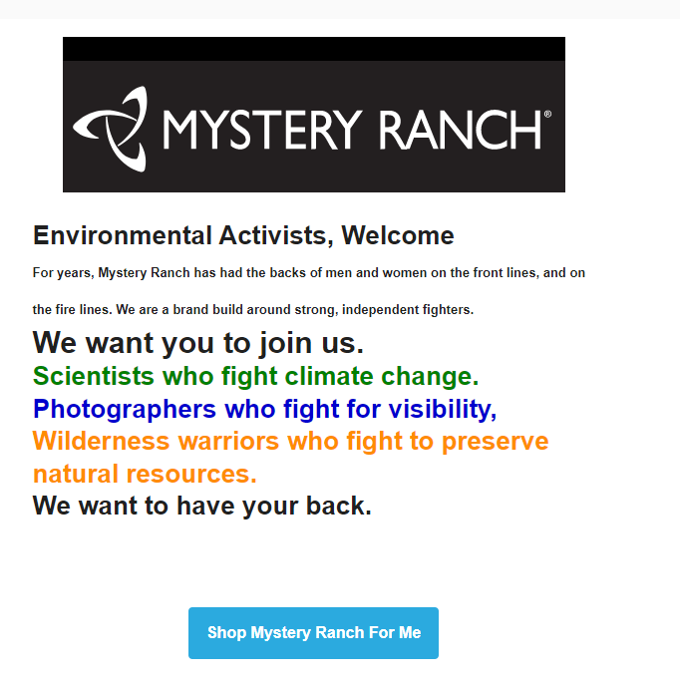
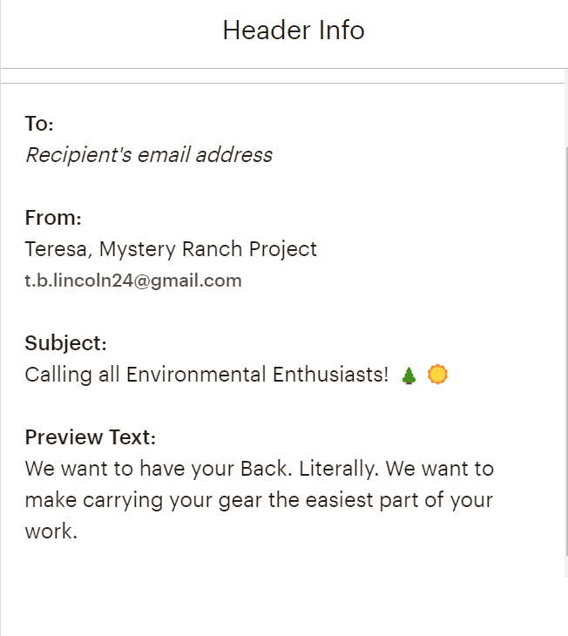
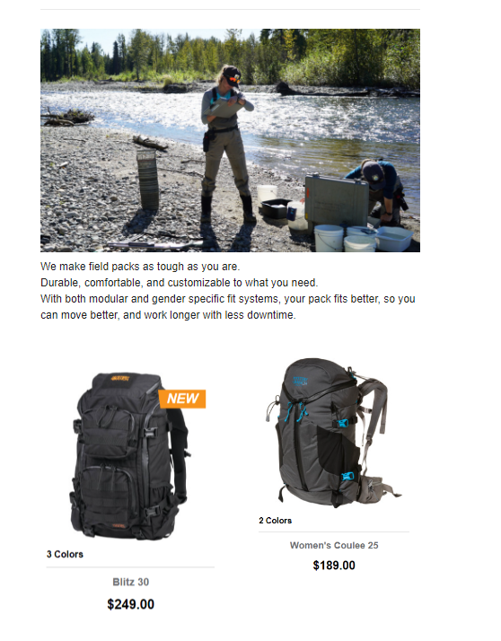
Email Marketing
The purpose of this email is to begin the introduction process of Mystery Ranch as a brand to a new clientele, but the target market of outdoor professionals. Based on responses to this email, open rates, Click to follow links, and CTR on the landing pages or shopping pages, more specific emails will follow.

Slide 13
Email Marketing Segmentation
Lists can also be segmented to target different groups of people within the outdoor professionals’ category. Example segments could be:
  Natural Resources and Foresters working in Timber and apprentice/interns
  Longleaf Alliance members
  Nature Conservancy Members
  Wildlife Biologists and students/recent grads
  Fisheries and Hatcheries Biologists and students/recent grads
  Wildlife Photographers specializing in animals
  Landscape/scenery photographers
Once there are segmented email marketing in place, there will be an option to sign up for emails and newsletters from Mystery Ranch. By allowing email recipients to sign up for email on a segmented and targeted email (rather than a generic introduction email) it will be easer to collect data, and see what targets are being met and which are being missed.

Slide 14
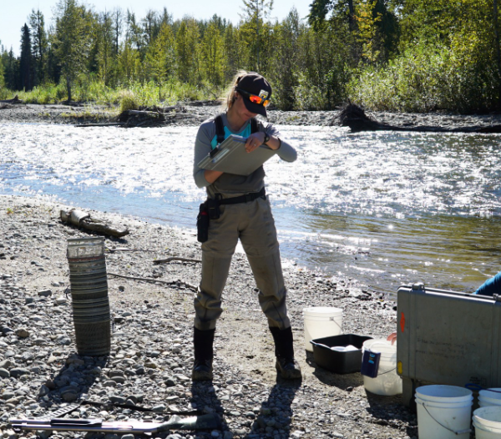
The Big Goal-
Specific Landing page
The landing page will bring customers into the page that tells stories, not features product. Mystery Ranch is a brand that relies on a foundation of trust. A customer is expecting to see products, when we can show them people who look like them, and work like them, trust is likely to follow.

Slide 15
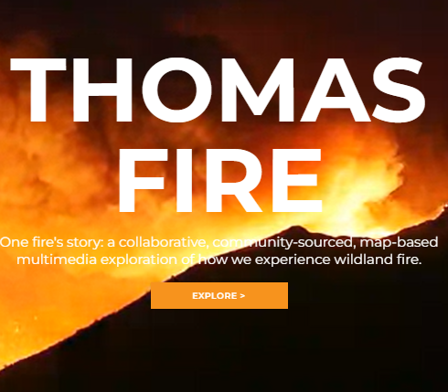
Still Crazy Productions
One of the most powerful tab on the mystery Ranch Website is the Thomas Fire and Montecito Debris Flow story.
Mystery Ranch will utilize influencers in the field who are willing to tell their story, sit for interviews for monetary compensation, to build stories and features around the different types of people who the Environmental Advocates campaign is looking to target.
After watching the video, a new customer should feel visible within their community, and inspired to inspire.

Slide 16
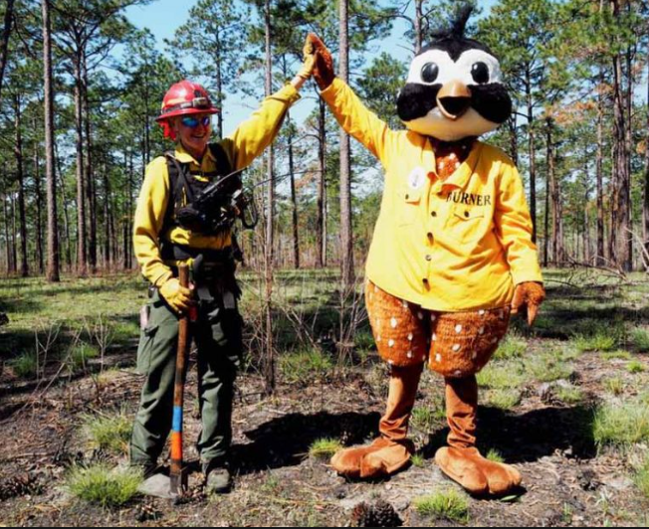
Event Marketing
Andalusia, Al
Introduction to Prescribed Fire Photography
With partnership with the Longleaf Alliance
Opportunity to lean on the Brand trust from the Wildland Fire community to branch into the Photographer Community in an regional area where Mystery Ranch has a lot of target Market representation, but no brand visibility.

Slide 17
Timeline and Measurements
Timeline
Measurements
The Environmental Advocates will be a new long term marketing focus, but will receive most of the Marketing attention between April and August of 2023.
The timeline of April-August will align with the seasonality of Field work.
Mystery Ranch is not expecting to see an immediate correlation with sales, but will be measuring how many customers click a link to the landing page
How many customers scroll all the way through the story,
How many website visitors leave the story page to a product page.

Slide 18
Tone and Conclusion
Newly exposed customers in the Environmental Advocate campaign should feel seen, inspired and validated. They should feel proud of the work that they do, and feel welcomed into the Mystery Ranch brand. The positive association and feelings of pride will be connected between outdoor occupations and pastimes with a feeling of accomplishment. Mystery Ranch will use subtle but emotional marketing to make customers realize that Mystery Ranch is a brand that cares about helping people like them do their job and live out their passion.
Mystery Ranch is not expecting to see an immediate correlation with sales, but will be measuring how many customers click a link to the landing page, how many customers scroll all the way through the story, and how many website visitors leave the story page to a product page. This campaign is about creating visibility and gaining trust. If those two factors are met, sales will come.

Slide 19
Teresa Babin-Lincoln
MKTG 270
Champlain College, Dec 2022

